Slide 1
CE303: Advanced Programming
Dr Michael Kampouridis mkampo@essex.ac.uk
WARNING: Please note module title!

Slide 2
Part I
Module information

Slide 3
Organisation
Weekly 2h lecture and 2h lab session
Again, keep in mind this is a 3rd year *optional* module – it’s called Advanced Programming for a reason!
We do not start from scratch; everything you’ve been taught before in Years 1 and 2 is assumed knowledge
For the labs, please come to the STEM building labs
Solutions for lab exercises already provided on Moodle
Assignment: 60% (Programming in Java)
Expect it to be demanding and not something you will solve in 2 days!
Progress tests (two) during Autumn term: 40% (20% each)
Weeks 7 and 11
Summer exam: None

Slide 4
Main Tools
Java, Haskell
We’re not going to go “deep” in and Haskell
The idea is to expose you to different languages and paradigms
Java is still the “main” language for this module
IntelliJ
You can use other IDEs, but we may not be able to assist you with problems
Notes:
You can download these for free.

Slide 5
History, Acknowledgement and SAMT
Some material is derived from textbooks and from other resources listed on the CE303 web page and / or the notes section in the PowerPoint files
No specific textbook
Slides should be enough to complete exercises / assignments / exams
Obviously you are free to look up online material if you feel like
SAMT student feedback in recent years has been mostly positive
Negative comments often arose from students who took this module without having the necessary Java programming skills and thus struggled to keep up with the advanced nature of the material

Slide 6
Java Review (… and beyond)
Note: the first half of the lecture (Parts II and III) are concepts you should already be familiar

Slide 7
Part II
Inheritance

Slide 8
Inheritance
A class can extend another class
the subclass inherits from the super (“parent”) class
A subclass inherits all features from its parent
Attributes and methods
Also inherits inherited features
Some inherited features may not be accessible
A subclass can hide parent attributes
Careful, this can be very confusing!
We’ll talk more about it later
A subclass can override parent methods
In Java, a class extends at most one other class
single-rooted hierarchy, no multiple inheritance
every class inherits from java.lang.Object
Notes:
Hiding : Happens during inheritance (between superclass and subclass).
Shadowing : Happens within a class (between a member variable and local variable).
https://techsymphony.wordpress.com/2011/01/23/difference-between-hiding-and-shadowing-in-java/#:~:text=Hiding%20%3A%20Happens%20during%20inheritance%20(between,member%20variable%20and%20local%20variable).&text=%E2%80%9Ccity%E2%80%9D%20in%20Child%20hides%20the%20one%20in%20Parent.

Slide 9
Inheritance - Overriding a method
To override a super class method in a sub class
declare a method with the same name and the same number and type of parameters in the same order, and a compatible return type
In Java any method of the super class can be overridden unless it is declared final.
Also, the overriding method has to be “at least as visible” as
the original method.
you can not make a public method have package access by overriding it
The “compatible return type” means that the overriding
method can return a more specialized result
“covariant return types”

Slide 10
public class Employee {
protected String name;
protected double salary;
public Employee(String aName, double aSalary) { name = aName; salary = aSalary; }
public void setSalary(double aSalary) {salary = aSalary;}
public String getName() { return name; }
public double getSalary() { return salary; }
}
public class Manager extends Employee {
public double bonus;
public Manager(String aName, double aSalary, double aBonus) { super(aName, aSalary); bonus = aBonus; }
void setBonus(double aBonus) {bonus = aBonus;}
public double getSalary() { return salary+bonus; }
}

Slide 11
"Covariant Return Type" Example
public class Employee {
…
public Employee copy(){
return new Employee(name, salary);
}
}
public class Manager extends Employee {
…
public Manager copy(){
return new Manager(name, salary, bonus);
}
}
Notes:
Covariant return type of a method is one that can be replaced by a “narrower” type when the method is overridden in a subclass.

Slide 12
Invoking Superclass Methods & Constructors
A class can not access private features of its super class.
Superclass methods
if a subclass overrides a parent method, use super
keyword to force method call of parent
there is no super.super (it would bypass the parent class)
Superclass constructors
Can explicitly use super to call a parent class construct. Must be first statement in subclass constructor in this case.
If a constructor does not call super explicitly, then the superclass must have a constructor without parameters which will be called implicitly
Calling super-class constructors happens before initialisation and execution of rest of constructor body.

Slide 13
toString()
Returns a string representation
especially useful for debugging
Method is used silently in string concatenation
aString + anObject
means
aString + anObject.toString()
Object.toString() gives class name and object address.
Some IDES have a wizard for generating toString() methods
Use it!

Slide 14
Overriding toString()using super
public class Employee {
…
public String toString() { return getClass().getName() +
“[name=” + name + “, salary=” + salary + “]”;
}
}
public class Manager extends Employee {
…
public String toString() { return super.toString() +
“[bonus=” + bonus + “]”;
}
}

Slide 15
Hiding Attributes and Class Methods
An attribute in a subclass hides an attribute with
the same name in a parent class
even if attribute has different type
hiding of attributes is in general not recommended
be careful not to accidentally hide attributes
the parent class attribute can still be accessed using the keyword super
A static method in a subclass “hides” a static method with the same name in a parent class.
Can still call the “hidden” method by prefixing the method
name with the class name.

Slide 16
Static
static keyword means that the member is shared by all the instances of the class, e.g. field x can be accessed from any instance of A:
public class A
{
private static int x = 0;
...
}
One cannot access this or any non-static members from a static method
Do not change every member to static to avoid compilation errors; reconsider your design instead!

Slide 17
Abstract Classes and Methods
An abstract class cannot be instantiated - you can not create objects belonging to such a class.
An abstract class can contain
abstract (= un-implemented) methods
implemented methods
data members.
Abstract methods can only be defined in abstract classes and in interfaces
Abstract classes are useful to define “incomplete” roots of an inheritance hierarchy
Concrete subclasses must implement all abstract methods.

Slide 18
Shape Class
public abstract class Shape {
protected | double | x;
protected | double | y;
public abstract double area(); public abstract double perimeter();
public String toString(){ …}
}

Slide 19
Extending an Abstract Class
Rectangle double a
double b
Rectangle(x,y,a,b) double area() double perimeter()
Shape
double x double y
double area() double perimeter() String toString()
Circle
double r
Circle(x,y,r)
double area()
double perimeter()

Slide 20
Why/when use Inheritance?
Different classes may have variations of the same operation that share certain parts
put shared code into the super class
this avoids duplication of code which is a good thing
Inheritance should only be used when there is an “is-a”
relationship between parent and subclass.
The subclass extends the parent with additional features
Car is a subclass of Vehicle? Okay
Car is a subclass of Driver? NO! A driver HAS a car.

Slide 21
Object Composition as an Alternative to Inheritance
Often, it is preferable to compose new classes from old classes by using objects as fields.
Instead of inheriting methods, the new class delegate requests to the field objects
The CalculatorWatch example below shows three design alternatives for combing two existing classes into a new class
No multiple inheritance in Java

Slide 22
Object Composition (Delegation)
Watch
watchState
setTime(t) getTime()
Calculator
calculatorState
enterCalcMode() inputNumber(n)
CalculatorWatch
watch: Watch calc: Calculator
setTime(t) getTime() enterCalcMode() inputNumber(n)

Slide 23
Combining Inheritance with Composition
Watch
watchState
setTime(t) getTime()
Calculator
calculatorState
enterCalcMode() inputNumber(n)
CalculatorWatch1
calc: Calculator
enterCalcMode() inputNumber(n)
CalculatorWatch2
watch: Watch
setTime(t) getTime()

Slide 24
Part III
Interfaces

Slide 25
Interfaces
An interface can be seen as a contract on classes
A class that implements the interface must comply with the contract.
A class can implement more than one interface
Interfaces are types, but they are not classes
they cannot be instantiated
Interfaces can contain
constants
method signatures (= implicitly abstract)
default methods (NEW since Java 8)
static methods (NEW since Java 8)

Slide 26
Using Interfaces
An interface cannot be instantiated, but you can use it as the type of variables, or method arguments and results :
List<Integer> xs = new ArrayList<>();
Here is a generic sum method that works on an interface type.
public static int sum (Collection<Integer> xs){
int result = 0;
for (int x : xs)
result += x;
return result;
}

Slide 27
Enhanced for-loop (“for-each”)
for (T x : xs) …
is a shorthand for
Iterator<T> it = xs.iterator();
while (it.hasNext()) {T x = it.next(); … }
Shorter, more readable code
Very much recommended
But not as powerful as using iterators directly
For example, cannot remove visited elements, or iterate “in sync” over two collections at the same time
We’ll see examples in the labs
Can also be used for arrays, and for any class implementing
the Iterable interface.

Slide 28
Polymorphism
Polymorphism code works for more than one type
Recognisable by the presence of interfaces, super-classes or generics
Examples:
Collections.sort() will sort any list provided the class of elements implements interface Comparable
Method sum() in the earlier slide works for any class implementing the interface Collection<Integer>

Slide 29
Static Typing and Dynamic Binding
Polymorphism means that the class of an object might not be known until runtime. In these cases, the compiler does not know which method will need to be executed.
Static typing happens at compile time. Its aim is to ensure that
objects have the required operations at runtime.
At runtime the executed operation is chosen according to the class of the object.
This is known as dynamic binding.

Slide 30
Polymorphism (Dynamic Binding)
Polymorphism enables code to change behaviour depending on the type of the object; hence polymorphism uses dynamic binding
A method can be redefined in a child class, and whenever that method is called for an object of the child class, the redefined implementation will be invoked
In Java, polymorphism is always enabled
Non-static methods never shadow each other
The implementation of the method is selected based on the actual type of the object, not the type of the variable (hence dynamic binding)

Slide 31
Overloading (Static Binding)
Java supports overloading, i.e. methods with the same name but different signatures:
double average (double x, double y) {…}
double average (double[] x) {…}
double average (Collection<Double> x) {…}
Overloading is resolved using static binding, i.e. the binding happens at compile time
In other words, the actual type of an object passed to a method does not affect which method will be invoked

Slide 32
Part IV
New (…ish) additions to Interfaces

Slide 33
Interfaces
Java interfaces can contain
Constants
Method signatures (implicitly abstract)
Default methods (since Java 8)
Static methods (since Java 8)

Slide 34
Default Methods in Interfaces
Since Java 8, you can define default methods in interfaces
These methods are NOT abstract, they come with an implementation
Default methods do not have to be implemented in classes that implement an interface
Although they can be overridden if desired
Why does anyone need them?
You can evolve an interface by adding further “default methods” to it without forcing an update of all of the existing classes that implement the interface
This has made it possible to retrofit additional methods to standard API interfaces (like Collection or Comparator) without breaking backward compatibility (i.e. without having to go and override all these new default methods in classes that implement the relevant interface)

Slide 35
Default Methods: Comparator Example
interface Comparator<T> { int compare(T o1, T o2);
...
// Returns a comparator that imposes the reverse // ordering of this comparator. default Comparator<T> reversed() // Returns a lexicographic-order comparator // with another comparator. default Comparator<T> thenComparing( Comparator<? super T> other)
... }

Slide 36
Default methods: conflict resolution
If a class inherits several implementations of a method with the same name, we could have multiple inheritance conflicts
How are they resolved?
Inheritance from a class has priority over inheritance from an interface
Derived interfaces or sub-interfaces take higher precedence than the interfaces higher-up in the inheritance hierarchy
If you code a new class that implements different interfaces which share the same method, and it is declared as default in at least one of them, then the method has to be explicitly overridden in the new class

Slide 37
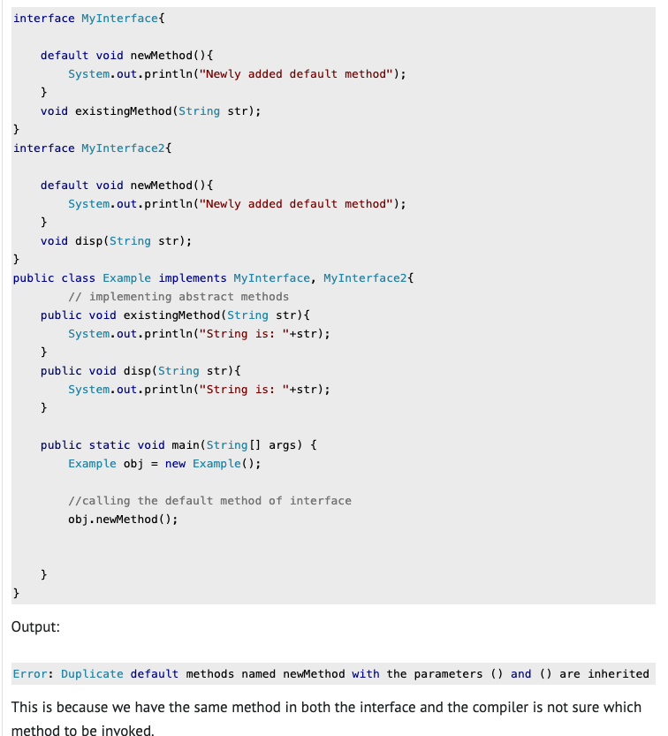
Multiple inheritance problem
Notes:
From: https://beginnersbook.com/2017/10/java-8-interface-changes-default-method-and-static-method/

Slide 38
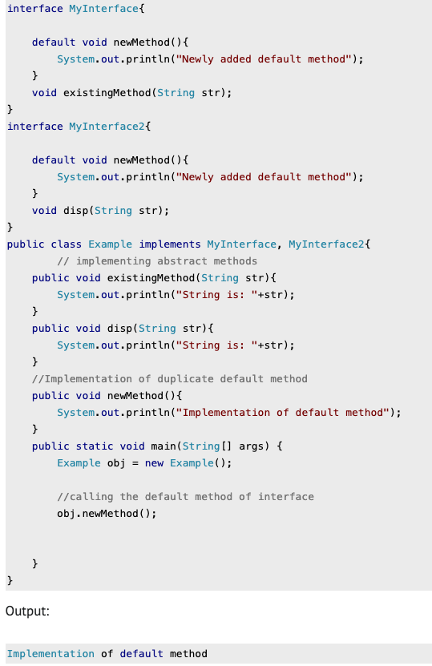
Multiple inheritance problem: how to resolve
Notes:
From: https://beginnersbook.com/2017/10/java-8-interface-changes-default-method-and-static-method/

Slide 39
static methods in interfaces
Java interfaces can also contain static methods
Similar to default methods
But since they are static, we cannot override them in the implementation classes
Having static methods in interfaces does not create a multiple inheritance problem
Why? Because we don’t have to override them in the implementation classes, as we have to do with default methods

Slide 40
PART V
Functional interfaces
Lambda expressions

Slide 41
Functional interfaces
Sometimes you may want to define a reference to a method; for example, you may want to pass a method to another method
In Java, the best we can do about this is to use a functional interface, i.e. interface with a single abstract method (SAM)
Below we define an interface MyPredicate as a reference to a method that takes one int parameter and returns a boolean:
interface MyPredicate
{
boolean apply(int value);
}
This type of interface is also called a Single Abstract Method (SAM) interface
Notes:
By having a single abstract method, I've essentially allowed the interface to be used as a method. Whenever I reference the interface (e.g. passing it as an argument to a method), I'm essentially using the method.

Slide 42
Functional interfaces
Then we define a class implementing MyPredicate:
class SelectPositive implements MyPredicate { @Override public boolean apply(int value) { return value > 0; } }
We define another method taking a method of this form as an argument void printSelected(int[] list, MyPredicate select){ for (int i = 0; i < list.length; i++) if (select.apply(list[i])) System.out.println(list[i]); }

Slide 43
Functional interfaces
Lastly, we simply have to call printSelected
printSelected(list, new SelectPositive());

Slide 44
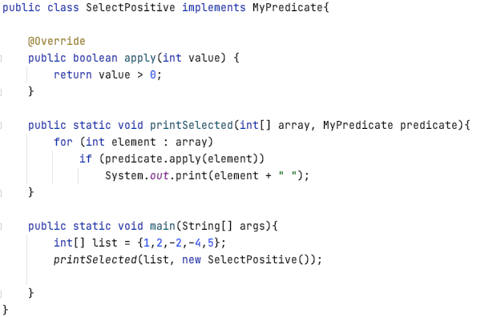
Putting it all together

Slide 45
Functional interfaces
java.util.function package defines various general functional interfaces
Function<T,R>, BiFunction<T,U,R>, Predicate<T>
UnaryOperator<T>, BinaryOperator<T>
Consumer<T>, Supplier<T>
And lots of specialisations for primitive types like
IntToDoubleFunction, ToDoubleBiFunction, DoublePredicate, IntBinaryOperator, LongConsumer, …
Having these specialisations improves efficiency, but it is rather ugly to have 40+ different interface definitions!

Slide 46
Lambda expressions
We said that to call the method, we write
printSelected(list, new SelectPositive());
But before that we needed to implement an interface and override its method
We can avoid doing this by using lambda expressions
Java supports anonymous classes but they still require quite a lot of hard-to-read code (i.e. implementing the interface; overriding the interface method; creating a new object; calling the method) for a simple task
Instead, you can use a lambda expression
printSelected(list, x -> x > 0);
Notes:
With lambda expressions, you do *not* have to implement the Interface (public class X implements MyInterface); so you skip that implementation, and also the interface’s method implementation. Instead, you just put the method definition as a lambda expression.

Slide 47
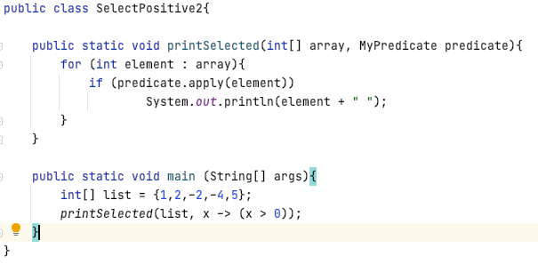
Updated SelectPositive (with lambda expression)

Slide 48
Lambda Expression Syntax
Parameter List
(int x, int y)
Arrow Token
->
Body
x + y
The body can be either a single expression or a block.
In the expression form, the body is simply evaluated and returned.
In the block form, the body is evaluated like a method body and a return statement returns control to the caller of the anonymous method. If the body produces a result, every control path must return something or throw an exception.
The parameter list can be empty: () -> …
Parameter types can be omitted. The compiler will in this case
infer types based on the “target type” of the place in the program
where the lambda expression occurs.
If there is only one parameter, the brace can be omitted.

Slide 49
Lambda-Expressions: Remarks
Java lambda-expressions always belong to a “functional interface” type with the precise type depending on the context
IntBinaryOperator f = (a, b) -> a - b;
You cannot assign a lambda expression to an Object variable: Object obj = (a,b) -> a - b // does NOT compile

Slide 50
END OF LECTURE

